Slide 1


CSS Foundations
Building the Visual Architecture of the Modern Web
selector { property: value; }

Slide 2
Part 1: The Syntax
Rules, Selectors, and Property Declarations

Slide 3
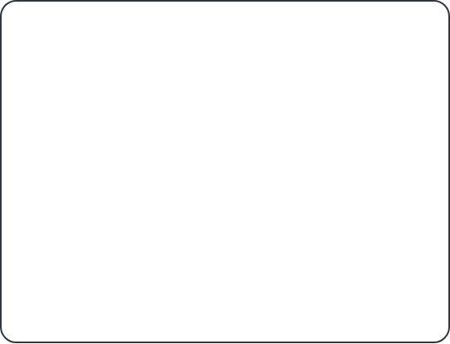
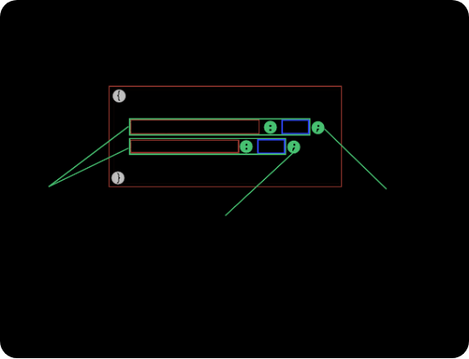
Anatomy of a CSS Rule
Selector: Targets the HTML element you want to style (e.g., h1, .button).
Property: The specific feature you want to change (e.g., color, font-size).
Value: The specific setting you apply (e.g., blue, 20px).

Slide 4

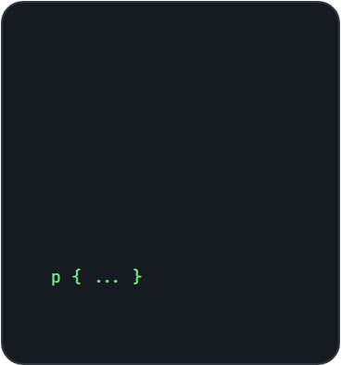

How to Connect CSS to HTML
1. Inline
2. Internal
3. External
Applied directly to the HTML tag via the style attribute.
Defined inside the </div> tag in the section.
Linked via a separate .css file. The professional standard.

Slide 5
Part 2: The Box Model
The Most Important Concept in CSS Layout

Slide 6
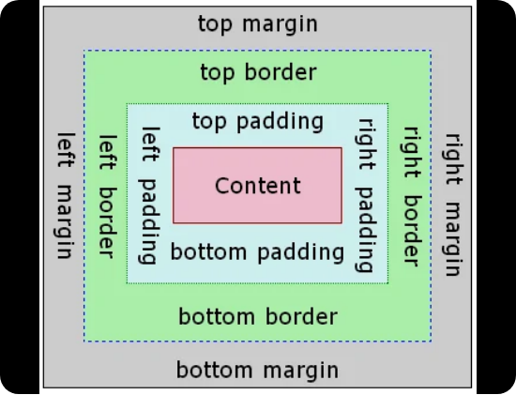
Understanding the Box Model
1. Content: The text or image itself.
2. Padding: Clear space around the content (inside the border).
3. Border: A line surrounding the padding and content.
4. Margin: Space outside the border (separates boxes).
Tip: Use box-sizing: border-box to make sizing intuitive!

Slide 7
Specificity: The Priority System
01
02
ID SELECTOR (#)
CLASS SELECTOR (.)
The strongest selector. Targets one unique element.
Medium priority. Can target multiple elements.
Element Selector (h1, p) Lowest Priority

Slide 8
Part 3: Layout & Units
Positioning Elements and Flexible Sizing

Slide 9






Common Display Properties
Block
Inline
Flex
Starts on a new line and takes full width (e.g., , ).
Does not start on a new line. Takes only as much width as needed (e.g., ).
A 1D layout powerhouse. Perfect for aligning items in a row or column.

Slide 10
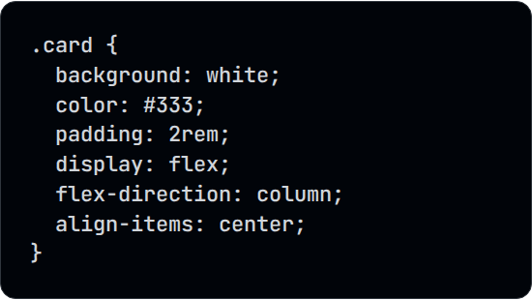
Lab: The Profile Card Challenge
Goal: Build a styled card with CSS.
1.
Create a div with the class "card".
2.
Set width: 350px and border-radius: 15px.
3.
Add padding: 20px and a box-shadow.
4.
Use Flexbox to center the text inside.

Slide 11
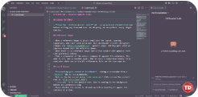
Any Questions?
"CSS is not just about making things look pretty. It's about structure and performance."

